Slide 1
Open Hardware Design for
BusKill Cord
Presented at DEFCON32 Demo Labs by Melanie Allen

Slide 2
Project Goal
Create a design for BusKill that is suitable for decentralized, home lab manufacture using 3D printing and easily sourced parts

Slide 3
Rationale
Allow high risk individuals a method to quickly secure sensitive information when separated from their laptops

Slide 4
BusKill Software Capabilities
Immediately upon USB-eject event:
Lock the computer
Shut down the computer
Shred your keys

Slide 5
BusKill Hardware Requirements
Be able to build in the home
Be inspectable
Not block other USB ports
Separate easily, yet not have false positives

Slide 6
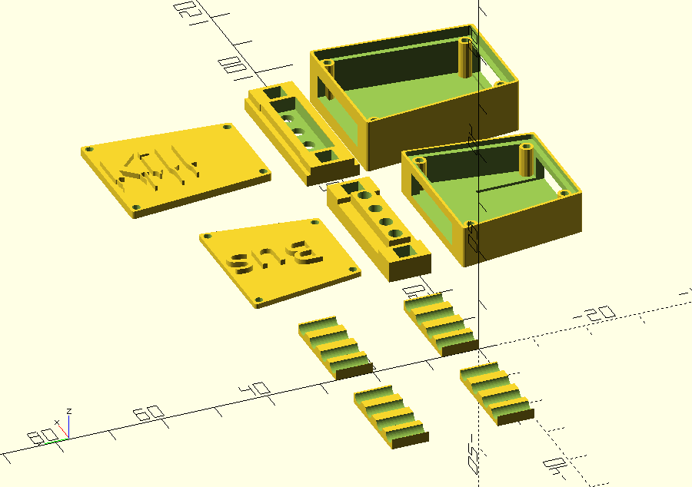
BusKill Diagram

Slide 7
Demo

Slide 8
Setting up BusKill on your laptop
Supports Linux, MacOS, and Windows
LUKS shredder overview
Qubes Overview (time/audience interest permitting)

Slide 9
Creating the hardware
Short history of development
Link to the repo
Explain the file and how to edit it

Slide 10
How you can help
Make one
Make it better
Help with software development or testing

Slide 11
References
BusKill web site
BusKill docs
BusKill repo
BusKill USB-A repo
LUKS shredder blog post

Slide 12
Q&A

